Slide 1

Balancing an Inverted Double Pendulum with Reinforcement Learning
Cem Alptürk and Pukashawar Pannu

Slide 2
Contents
Project Description
Problem Definition
Reinforcement Learning
Q-learning
Deep Q-learning
Project Structure
Results
Inverted Single Pendulum
Inverted Double Pendulum
Future Work

Slide 3
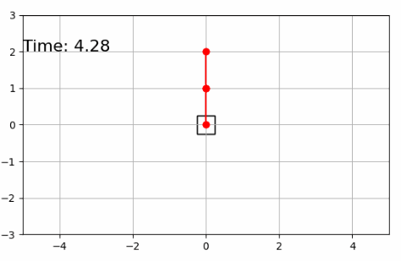
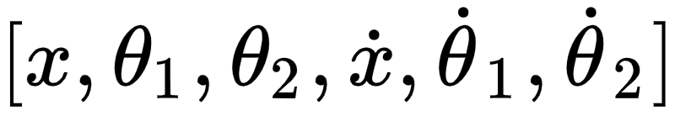
Problem Definition
Goal: Balance the inverted double pendulum
Chaotic system with one degree of freedom
The system is represented by 6 states:
Notes:
Balancing the pendulum is to keep the pendulums within an angle range

Slide 4
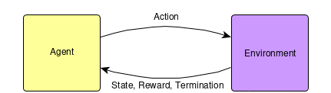
Reinforcement Learning
The agent interacts with the environment
The purpose is to learn from experience

Slide 5
Q-learning
Q-value represents the expected return for taking an action
Model-free method
Online policy learning
Uses Q-table to make decisions
Optimal Q-table is found with the Bellman Equation

Slide 6
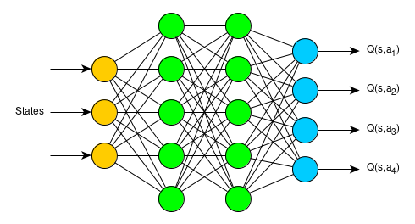
Deep Q-learning
Use a neural network to estimate the Q-table
Actions are decided by the Q-network

Slide 7
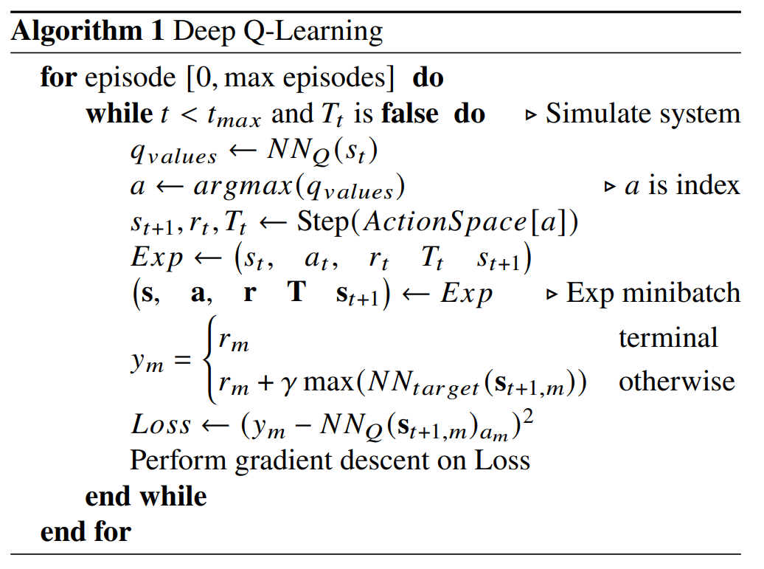
Deep Q-learning cont.
Experience replay is used to train
Targets for training are created by the Target-network

Slide 8
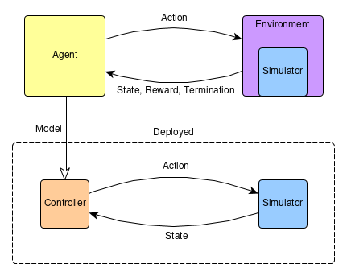
Project Structure
Simulator: Simulation of the system
Environment: Reward and termination conditions
Agent: Trains a controller by using Deep Q-learning
Controller: Interacts with the simulator to control the system.

Slide 9
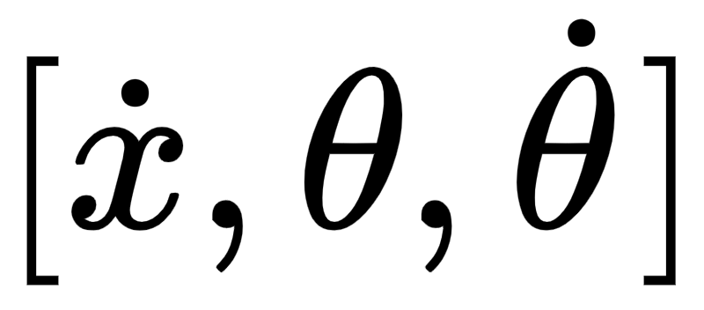
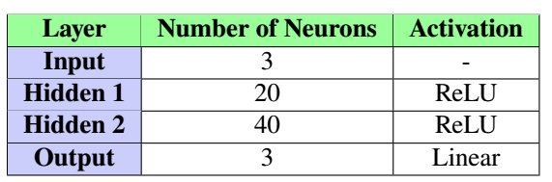
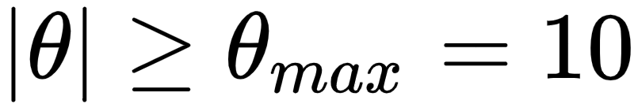
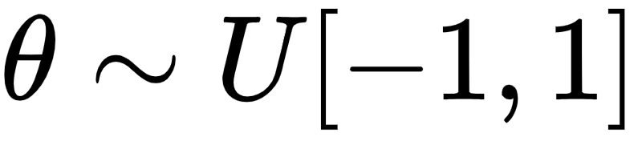
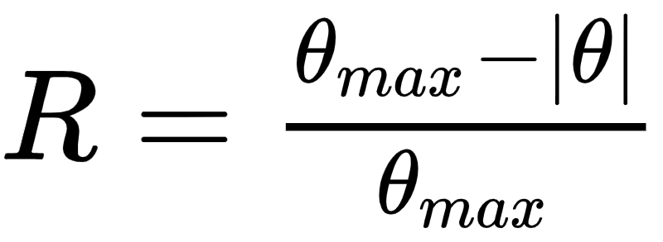
Single Pendulum
Action Space: [-10, 0, 10]
Inputs:
Termination:
Initial Conditions:
Reward:
Notes:
The cart position was disregarded as an input to reduce the number of states the network needs to account for.
Cart position does not affect how the controller needs to act to actually balance the pendulum.
Reward function did not take into account for the pendulum position - only focused on balancing the pendulum.

Slide 10
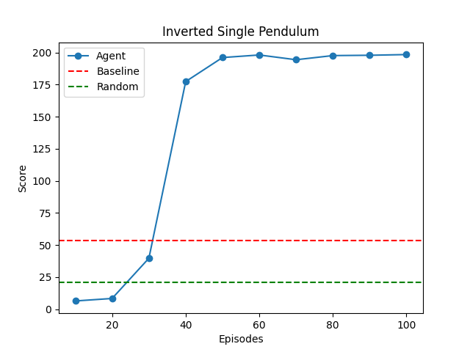
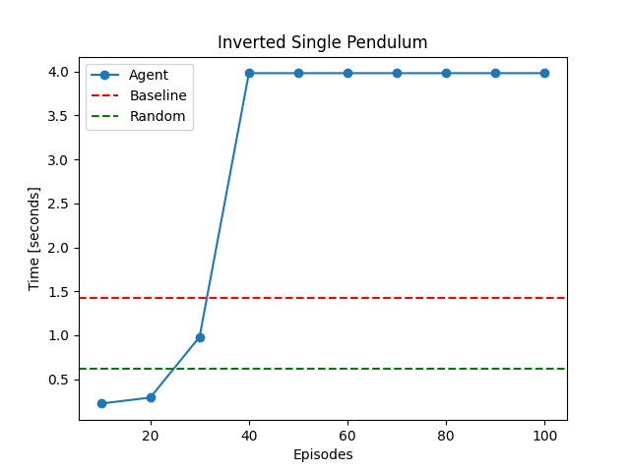
Single Pendulum Cont.

Slide 11
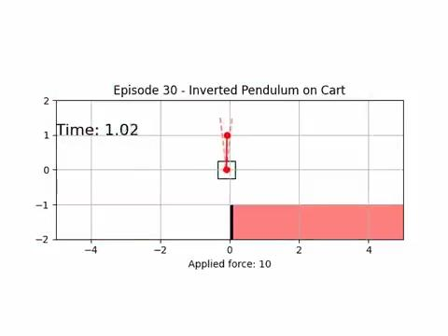
Single Pendulum Training

Slide 12
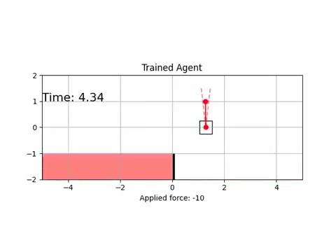
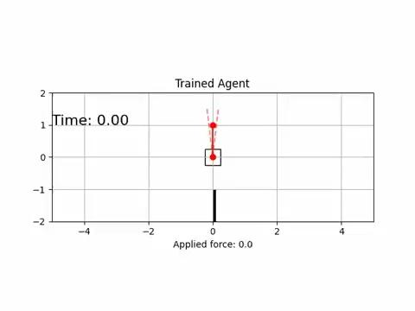
Single Pendulum Trained

Slide 13
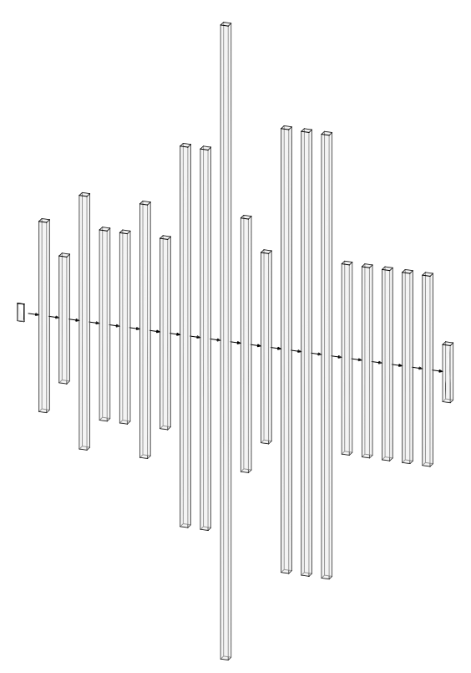
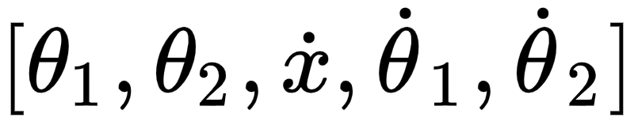
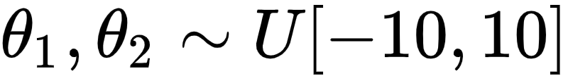
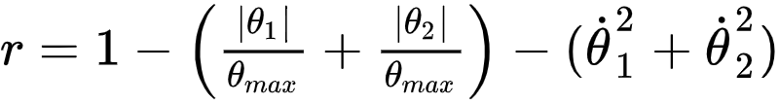
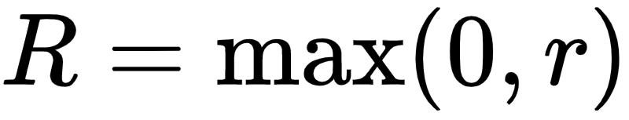
Double Pendulum
Action Space: [-40, -10, -5, -1, 0, 1, 5, 10, 40]
Inputs:
Termination:
Initial Conditions:
Reward:

Slide 14
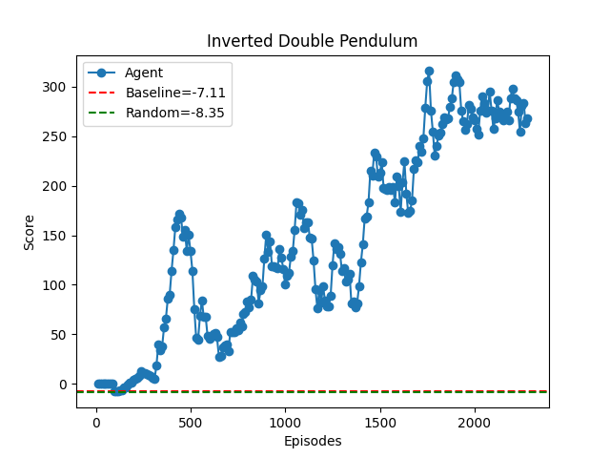
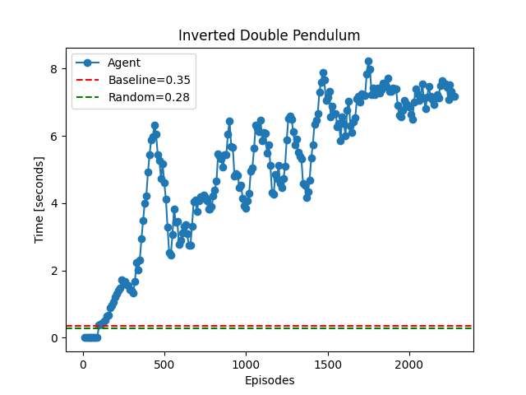
Double Pendulum Cont.
Notes:
24 hours simulation

Slide 15
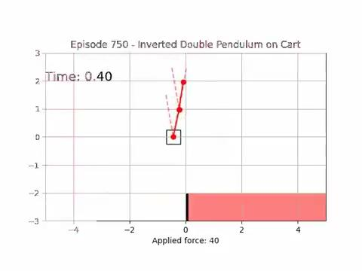
Double Pendulum Training

Slide 16
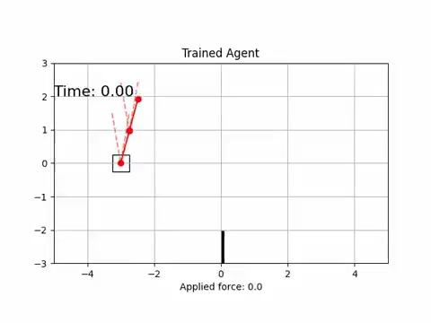
Double Pendulum Trained

Slide 17
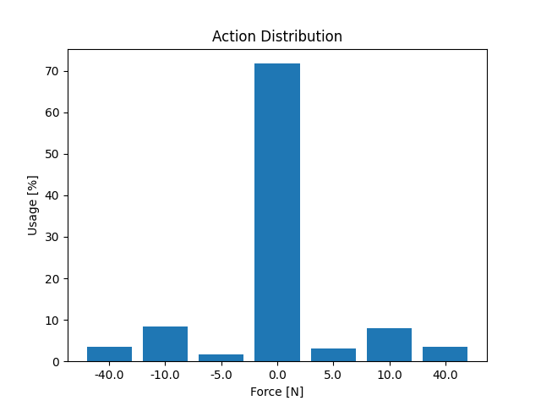
Force Distribution

Slide 18
Future Work
Tuning Hyperparameters
Reward based on the position of the cart
Swing up problem
Transfer Learning
Linear Q-learning
Double Q-learning
Notes:
Linear Q-learning: The Q-values are approximated by functions (linear/polynomial) constructed by the user

